Slide 1
Lessons Learned From Agile Quality Assurance In Scrum

Slide 2
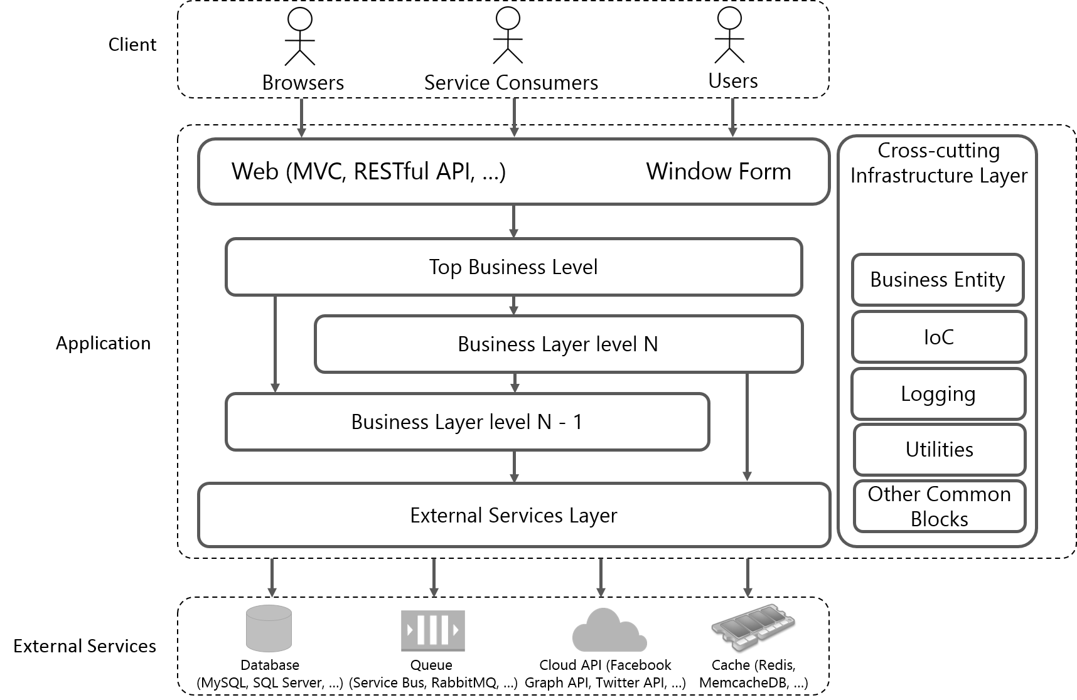
Product Quality The conceptual structure of an application to software testing

Slide 3
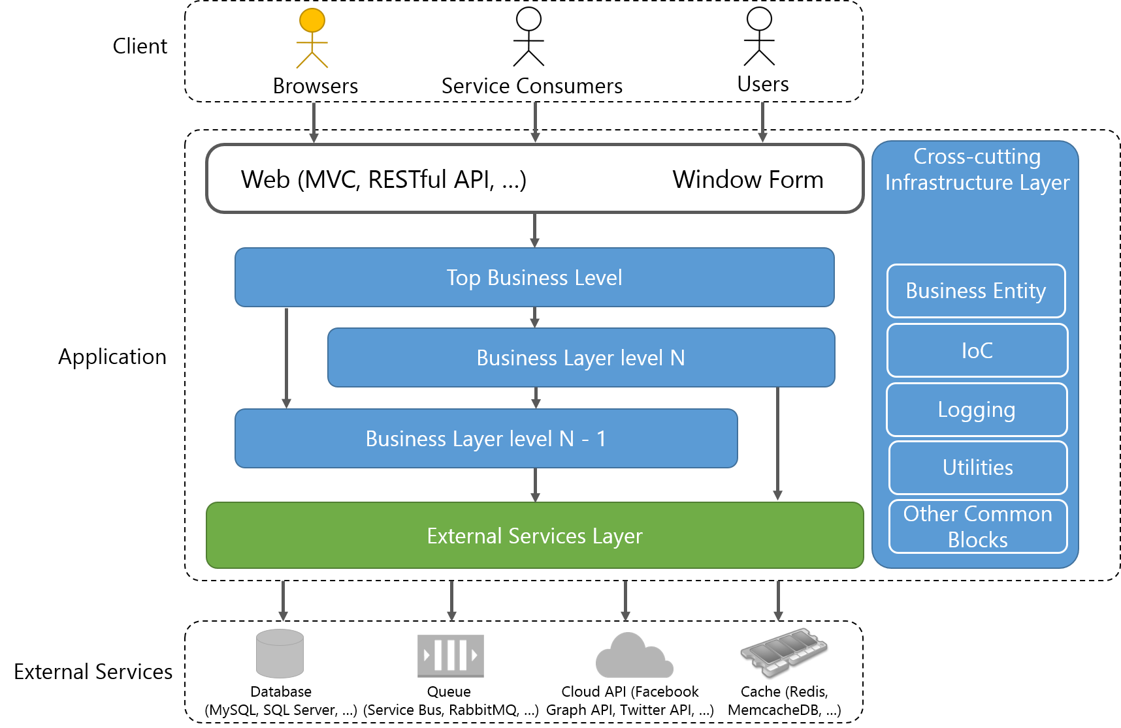
Product Quality  Software components and their testing
Covered by “GUI Unit” Testing
Covered by Unit Testing
Covered by Integration Testing

Slide 4
Product Quality  Software components and their testing

Slide 5

Product Quality  Perform “System Testing” to test the entire application
System Testing
Automated System Testing
Manual System Testing
End-To-End Testing
“Behind-The-Scenes” Testing
Simulate real user scenarios to test the entire application.
Call the top business level to test the application.

Slide 6
Product Quality  Demonstrate how we performed those types of testing
GUI Unit Testing
Integration Testing
Unit Testing

Slide 7
Product Quality  Demonstrate how we performed those types of testing
GUI Unit Testing
TODO: Show sample code and screenshots

Slide 8
Product Quality  Demonstrate how we performed those types of testing
Unit Testing
TODO: Show sample code and screenshots

Slide 9
Product Quality  Demonstrate how we performed those types of testing
Integration Testing
TODO: Show sample code and screenshots

Slide 10
Code Quality  Code review
When
Who
How
Benifits
Whenever new code is produced.
Peer developers
Assert coding conventions
Assert algorithms
Assert OOP design
Assert project conventions (file location, project name, configuration, etc.)
Code analysis tools
Detect hidden faults / bugs very soon.
Refactor code frequently.
Ensure coding conventions.
Prevent code from getting mess.

Slide 11
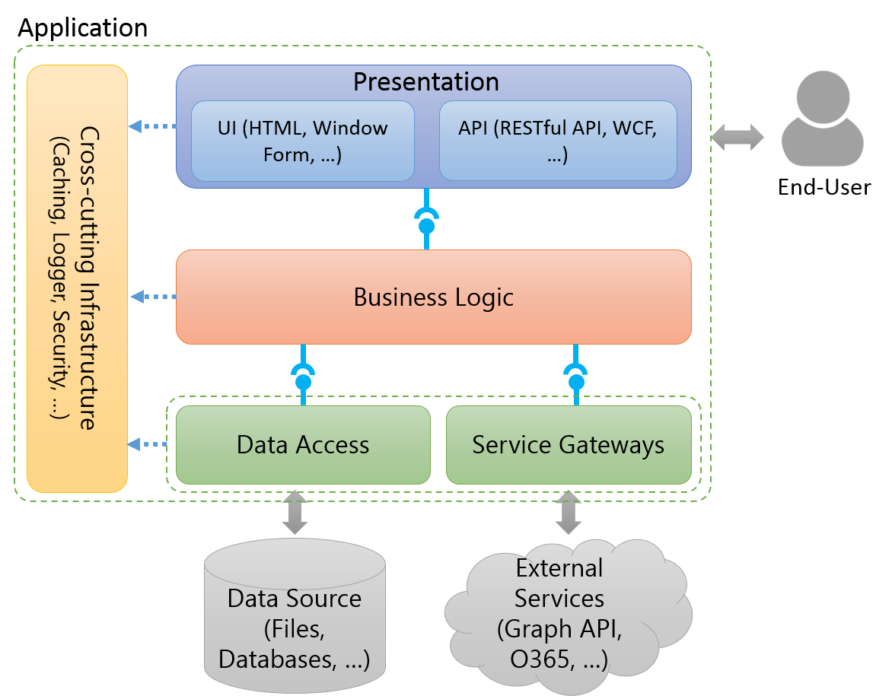
The conceptual structure of an application to software testing
Notes:
To talk something about the conceptual structure of an application to show to audiences the structure which is applied in almost applications.

Slide 12
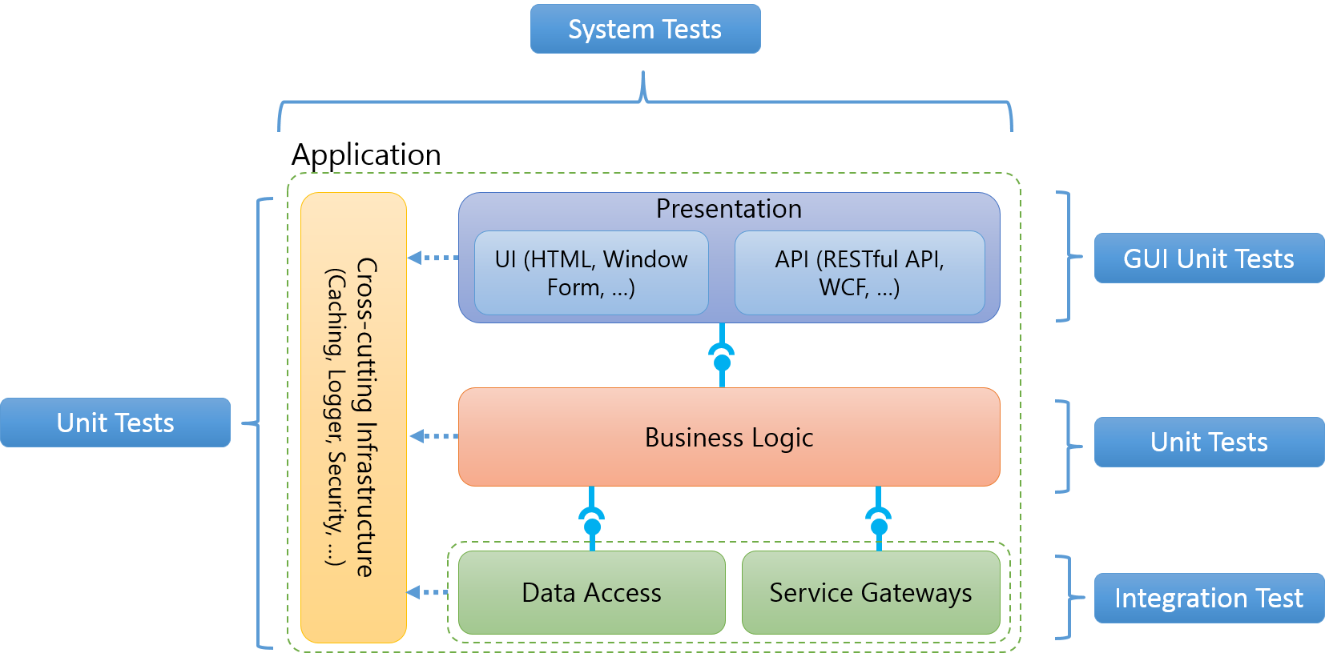
The conceptual structure of an application to software testing
Notes:
To indicate what aspects of an application are covered which types of test (Ex: Business Logic is covered by unit tests.)

Slide 13

Application
Cross-cutting Infrastructure
(Caching, Logger, Security, …)
Presentation
UI (HTML, Window Form, …)
API (RESTful API, WCF, …)
End-User
Business Logic
Data Access
Service Gateways
Data Source (Files, Databases, …)
External Services (Graph API, O365, …)

Slide 14
System Tests
Application
Cross-cutting Infrastructure
(Caching, Logger, Security, …)
Presentation
UI (HTML, Window Form, …)
API (RESTful API, WCF, …)
GUI Unit Tests
Unit Tests
Business Logic
Unit Tests
Data Access
Service Gateways
Integration Test
Notes:
http://blogs.msdn.com/b/jmeier/archive/2008/11/24/application-architecture-diagrams-added-to-codeplex.aspx

Slide 15




Client
Browser
Web Server
Business Entity
Presentation
Cross-cutting Infrastructure
UI (MVC, Window Form, …)
API (RESTful API, WCF, …)
Configuration
Business Logic
Logging
Utilities
Service Gateways
Other Common Blocks
Database
(Cassandra, MongoDb, …)
Queue
(Service Bus, RabbitMQ, …)
Cloud API (Facebook Graph API, Twitter API, …)
Memcache (Redis, MemcacheDB, …)
Notes:
http://blogs.msdn.com/b/jmeier/archive/2008/11/24/application-architecture-diagrams-added-to-codeplex.aspx

Slide 16


Client
Browsers
Service Consumers
Users
Web (MVC, RESTful API, …)
Window Form
Cross-cutting Infrastructure Layers
Top Business Level
Business Entity
Application
Business Layer level N
IoC
Logging
Business Layer level N - 1
Utilities
External Services Layer
Other Common Blocks
External Services
Database
(MySQL, SQL Server, …)
Queue
(Service Bus, RabbitMQ, …)
Cloud API (Facebook Graph API, Twitter API, …)
Cache (Redis, MemcacheDB, …)

Slide 17
Client
Browsers
Service Consumers
Users
Web (MVC, RESTful API, …)
Window Form
Cross-cutting Infrastructure Layers
Top Business Level
Business Entity
Application
Business Layer level N
IoC
Logging
Business Layer level N - 1
Utilities
External Services Layer
Other Common Blocks
External Services
Database
(MySQL, SQL Server, …)
Queue
(Service Bus, RabbitMQ, …)
Cloud API (Facebook Graph API, Twitter API, …)
Cache (Redis, MemcacheDB, …)

Slide 18
Covered by Unit Testing
Covered by GUI Unit Testing
Covered by Integration Testing

Slide 19

Client
Browsers
Service Consumers
Users
Web (MVC, RESTful API, …) Window Form
Cross-cutting Infrastructure Layer
Top Business Level
Business Entity
Application
Business Layer level N
IoC
Logging
Business Layer level N - 1
Utilities
External Services Layer
Other Common Blocks
External Services
Database
(MySQL, SQL Server, …)
Queue
(Service Bus, RabbitMQ, …)
Cloud API (Facebook Graph API, Twitter API, …)
Cache (Redis, MemcacheDB, …)

Slide 20

Client
Browsers
Service Consumers
Users
Web (MVC, RESTful API, …) Window Form
Cross-cutting Infrastructure Layer
Top Business Level
Business Entity
Application
Business Layer level N
IoC
Logging
Business Layer level N - 1
Utilities
External Services Layer
Other Common Blocks
External Services
Database
(MySQL, SQL Server, …)
Queue
(Service Bus, RabbitMQ, …)
Cloud API (Facebook Graph API, Twitter API, …)
Cache (Redis, MemcacheDB, …)

Slide 21
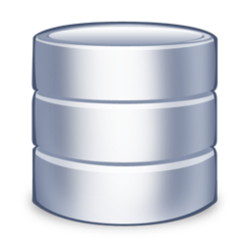
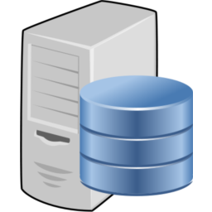

Source Repository
Build Server
Development Machine

